Slide 1

Fall
Prevention
for Clinical Services

Slide 2
Objectives
At the end of this module, the staff member will be able to:
Define fall and identify between witnessed, unwitnessed, near fall and assisted descent.
Verbalize staff responsibilities in relation to patient fall.
Identify different assessment tools used for falls appropriate to patient population.
Enumerate fall prevention strategies per hospital policy.
Verbalize communication and documentation process in relation to fall risk assessment and prevention.

Slide 3

Introduction
All patients are at risk for falls. Increased staff awareness and an effective fall prevention and management program is necessary to reduce patient injuries related to falls.

Slide 4
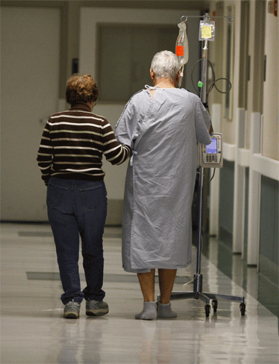
Introduction – cont’d
Up to 50% of hospital patients are at risk for falls, and those who fall commonly have longer hospital stays. Even more alarming, during the first month after discharge, injuries related to falls account for about 15% of all readmissions.
As the number of patient risk factors increases, so does the likelihood of falling. Therefore, identifying patients at risk for falling can significantly improve a hospital’s fall rate.
(American Nurse Today, March 2011, Vol. 6. No. 2)

Slide 5
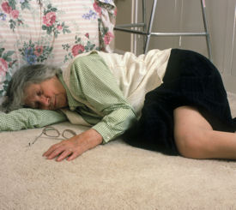
Introduction – cont’d
Nearly half of those who fall suffer moderate to severe injuries that limit their mobility and increase the risk of premature death. Up to 20% of falls cause serious injury, including fractures and accumulation of blood in the brain (subdural hematomas).

Slide 6
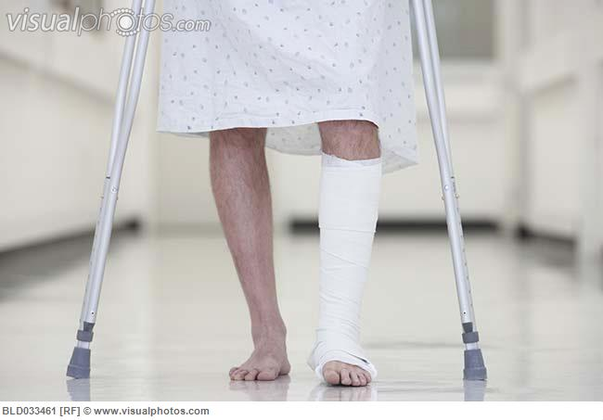
Introduction – cont’d
Even when a fall doesn’t lead to death, it can necessitate prolonged hospitalization. Many victims spend up to a year in recovery. Some suffer disability and loss of function and are unable to return to their homes; many end up losing their independence.
(American Nurse Today, March 2011, Vol. 6. No. 2)

Slide 7
Regulatory Agencies
Falls are reportable as a Sentinel Event per The Joint Commission and as endorsed by The National Quality Forum’s List of “Never Events”
Individual State Statutes, e.g. California Senate Bill 1301
The Department of Health Care Services outlines the following:
  Section 2702 of the Affordable Care Act directs States to develop and implement a plan that withholds Medicaid payments to hospitals for provider-preventable conditions (PPC) as defined in the regulation
  In California, the Department of Health Care Services (DHCS) has developed a State Plan Amendment (approved by CMS) to implement Section 2702

Slide 8
What We Know Right Now
At Dignity Health, for every patient fall with injury, there is a 25% chance that the event will become a claim. Once the event becomes a claim, the average cost is over $50k with the potential to reach over $1 million.

Slide 9
Fall Risk Assessment

Slide 10
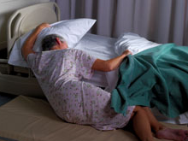
Definitions
FALL - a sudden uncontrolled, unintentional, downward displacement of the body to the ground or other surface, excluding falls resulting from violent blows or other purposeful actions.
NEAR FALL - a sudden loss of balance that does not result in a fall or other injury. This can include a person who slips, stumbles or trips but is able to regain control prior to falling.

Slide 11
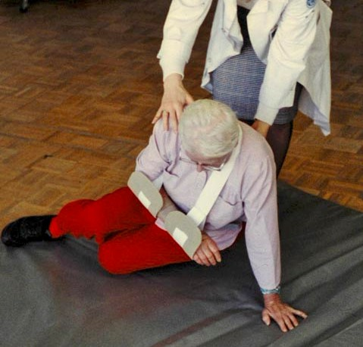
Definitions
unwitnessed fall - occurs when a patient is found on the floor and neither the patient nor anyone else knows how he/she got there.
ASSISTED DESCENT – an event in which any staff member was with the patient at the time of the fall and was able to ease the patient’s descent to the floor

Slide 12
Fall-Related Injuries
LEVEL OF INJURIES
None : No injury as a result of fall
Mild/Minor : Requires minor intervention (i.e. application of a dressing, ice, cleaning of a wound, limb elevation or topical administration), no loss of function
Moderate : Result includes sutures, closed reduction or splinting, temporary loss of function
Major : Results in casting, open reduction to correct fracture, dislocation or tissue injury, traction and/or permanent loss of function or death
Death : Fall determined to be the cause of death.

Slide 13
Fall Risk Assessment
A fall risk assessment will be completed by a licensed nurse for all patients admitted to the hospital and outpatient service areas and appropriate interventions will be implemented for those patients identified as high fall risk.
Reassessment will be done daily and/or after an operative or invasive procedure, unplanned change in mental status, other changes in medical status or following a fall.

Slide 14
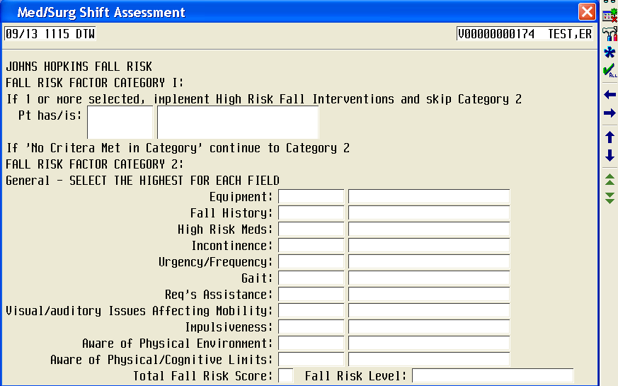
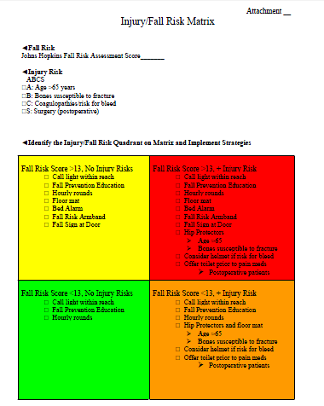
Fall Risk Assessment Tools
Johns Hopkins Fall Assessment Tool
Injury/Fall Risk Matrix
- used for all inpatient and outpatient surgery/ ambulatory care patients 13 years and older
- used for general patient population

Slide 15
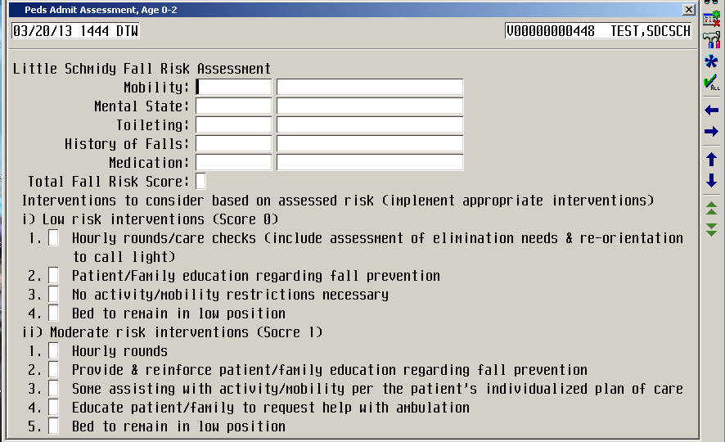
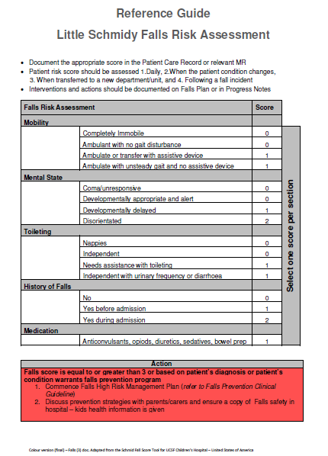
Fall Risk Assessment Tools
Little Schmidy Fall Assessment Tool
- used for pediatric patients including inpatient and outpatient surgery/ ambulatory care patients under 13 years old

Slide 16
Fall Risk Assessment Tools
Fall Assessment Tool
- used for all patients in PHP (Partial Hospitalization Program)

Slide 17
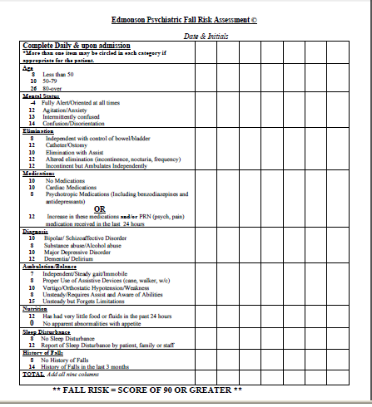
Fall Risk Assessment Tools
Edmonson Psychiatric Fall Risk Assessment
- used for all patients in the Behavioral Health Services (BHS)

Slide 18
Fall Risk Assessment Tools
Emergency Department Fall Assessment Tool
- used for all patients in the Emergency Department
Outpatient Safety Questionnaire
- outpatients will complete a self-assessment of fall risk
Assessment of fall risk factors and level of fall risk will be calculated by the receiving department on admission to inpatient unit, once per shift, and as needed (PRN) if the patient’s condition changes.

Slide 19

High Fall Risk Factors
INTRINSIC FACTORS – factors originating with the individual
Age-related changes (vision, balance and gait, psychological)
Changes in mental status
Medical conditions including Alzheimer’s disease and dementia
Muscle weakness
Multiple medications causing drowsiness or dizziness

Slide 20
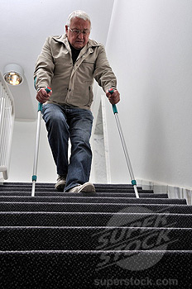
High Fall Risk Factors
EXTRINSIC FACTORS – factors originating outside the individual
Physical environment including poor lighting , condition of floors and stairs or presence of spills
Use of assistive devices (canes, walkers, wheelchairs)
Use of footwear (proper fit, slip-resistant soles or low heels)

Slide 21
Fall Prevention Strategies

Slide 22
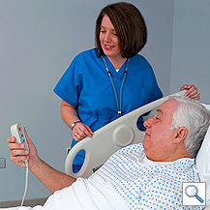
Fall Prevention Strategies
All patients will be assessed for presence of fall risk factors and will have the following interventions:
Orientation to call light, overhead light and bed controls
Location of bathrooms and whether to use the bathroom with or without assistance, and the unit routine
Beds will be placed in the low position with cables connected
The top two bedside rails will be raised for access to bed controls and functional call lights will be made accessible to the patient

Slide 23
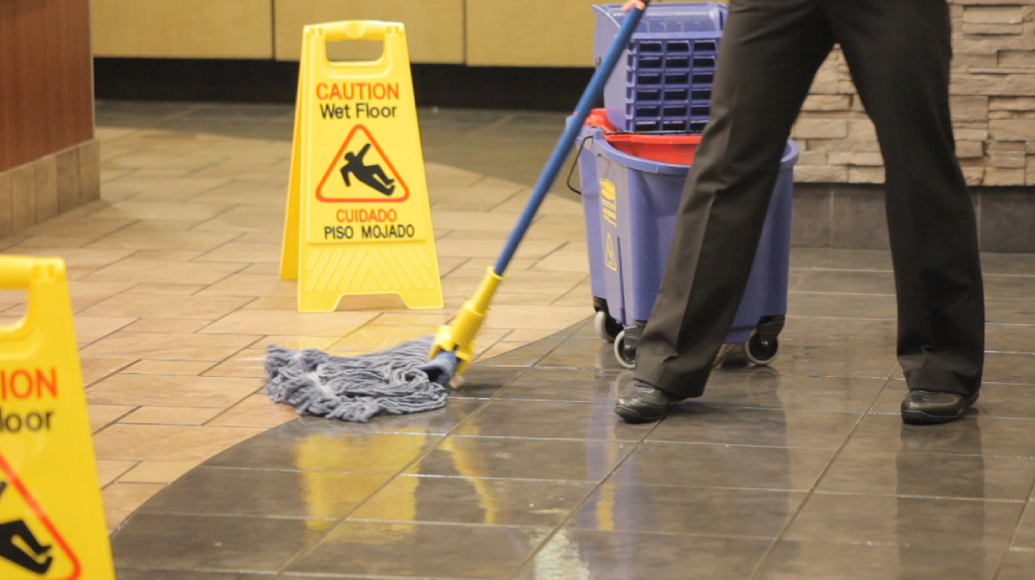
Fall Prevention Strategies
Spills in patient room or in hallway will be cleaned immediately. Signage will be placed to indicate wet floor danger and signage will be removed when floor is dry
Provide physically safe environment (eliminate spills, clutter, electrical cords and unnecessary equipments)
Excess equipments will be removed including supplies and furniture
Excess electrical and telephone wires will be coiled and secured
Actively engage patient and family in all aspects of the fall prevention program.

Slide 24
Fall Prevention Strategies
Patients with Elimination issues:
Patients with urgency and/or frequency will be placed near toilet or bedside commode will be provided
Patients who are receiving laxatives and/or diuretics will be checked at frequent intervals
Male patients will be encouraged to use a urinal while sitting or patient will be stabilized to stand if needs to void
Patients with Mobility issues:
Non-skid footwear will be provided
Assistive devices (i.e. walker, cane, gait belt) will be provided as needed
High-risk patients will be accompanied when out of bed and ambulating

Slide 25
Fall Prevention Strategies
Patients with Mental Status issues:
Confused patients will be placed near the nurse’s station when possible
Family members will be utilized to sit with confused patients when available
Doors/curtains will remain open when family or staff is not present
Sitter use may be considered as appropriate
Patients with Medication issues:
Patients will be monitored/educated on high risk medications that can cause altered mental status
Medications: sedatives, hypnotics, psychotropics, antidepressants, diuretics, laxatives, antoconvulsants, epidural/anesthesia, antihypertensives, PCA/opiates, anxiolytics, muscle relaxants, or any other medication that changes the patient’s cognition

Slide 26


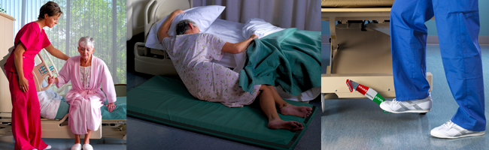
Fall Prevention Interventions
Depending on the fall risk assessment identified, any or all of the following fall prevention interventions may be used for inpatients:
Yellow booties
Yellow armband
Fall mat

Slide 27


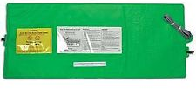

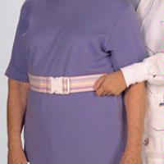

Fall Prevention Interventions
Yellow gown
Bed alarms
Hip protectors
Yellow magnets
Gait belt

Slide 28
Staff Responsibility
Registered Nurses (RNs)
Responsible for the initial and ongoing assessment of fall risk: implementation of fall prevention strategies as determined by fall risk category; reporting of patient falls and treatment of fall-related injuries
Licensed Vocational Nurses (LVNs)
Responsible for the implementation of fall risk prevention strategies as determined by fall risk category; reporting of patient falls and treatment of fall-related injuries
Unlicensed Nursing Staff
Responsible for the implementation of delegated interventions for patient at moderate or high fall risk; reporting of patient falls.
All CHSB Staff
Responsible for adhering to the established guidelines regarding fall risk assessment and interventions appropriate to individual staff roles

Slide 29
Staff Responsibility
If a patient meets fall risk criteria, this should be communicated to the healthcare team.
Be ready to assist in case a potential fall may occur --- access to light, presence of spills, transfers, etc
Remember ---
Safety is everybody’s business

Slide 30

Communication of Fall Risk
The patient’s fall risk status will be communicated to all members of the healthcare team, particularly if the patient will be leaving the unit for any reason.
Fall risk will be communicated during SBAR report between providers at shift change, transfer of patient between units and transfer from one nurse to another
Fall risk will be included on transportation SBAR report
Fall risk will be noted on any multidisciplinary care plan

Slide 31
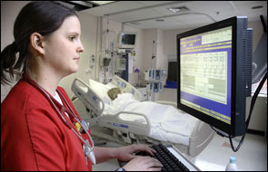
Documentation
The following information will be documented on all patients:
Initial fall risk upon admission
Reassessment every shift change and change of patient condition/status or acuity
Fall prevention implemented
Patient and family education

Slide 32
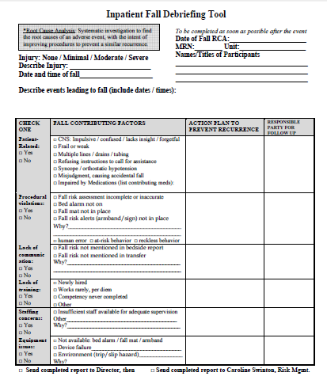
Post-Fall Debriefing
Debriefing is a process to discuss what happened, how a similar occurrence of fall will be prevented from happening again and placing a better communication and awareness on the unit whenever there is a fall.
Post-fall Debriefing Analysis must be completed for fall occurrence.

Slide 33
Reportable Conditions
Report to House Supervisor
Report all patient falls to House Supervisor, who will then initiate a “huddle” with all staff members to complete the “Fall Debriefing Analysis” form and will ensure that an IVOS Event report is completed
Report to physician/authorized prescriber
Patient fall, including any change in physical or mental status post-fall
Notify Risk Management
Significant injury involving transfer to higher level of care or medical/surgical intervention
Injury sustained confirmed by diagnostic test
Death occurs as a direct result of fall event
Event report and post fall assessment will be completed for any patient fall.

Slide 34
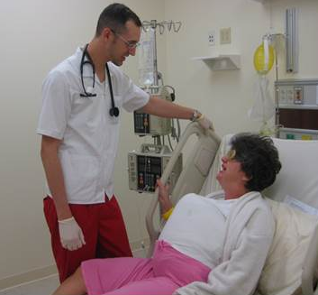
Patient/Family Education
Patient/Family will be educated on results of fall risk assessment and interventions utilized to maintain patient safety, and this education will be documented in the medical record.

Slide 35


