Slide 1
MyJourney LMS
(learning management system)
How to complete educational assignments and offerings in MyJourney

Slide 2
My Journey
The new learning management system (LMS) for Dignity Health
  Access to over 2000 classes
  Brush up on skills
  Learn new skills
  Some classes may require manager approval to take
  Some classes will be automatically assigned to you by education, corporate, or your manager or director.
  Some classes are time sensitive and will have a due date attached.
  A good practice is to go into MyJourney and Tracker Trainer once a week to complete any new educational requirements.

Slide 3
Required Education
Working in a hospital demands continuous education
There are always new products and new practices that need to be learned.
Equipment changes, processes change
Get into a habit of checking MyJourney & Tracker Trainer on a weekly basis

Slide 4
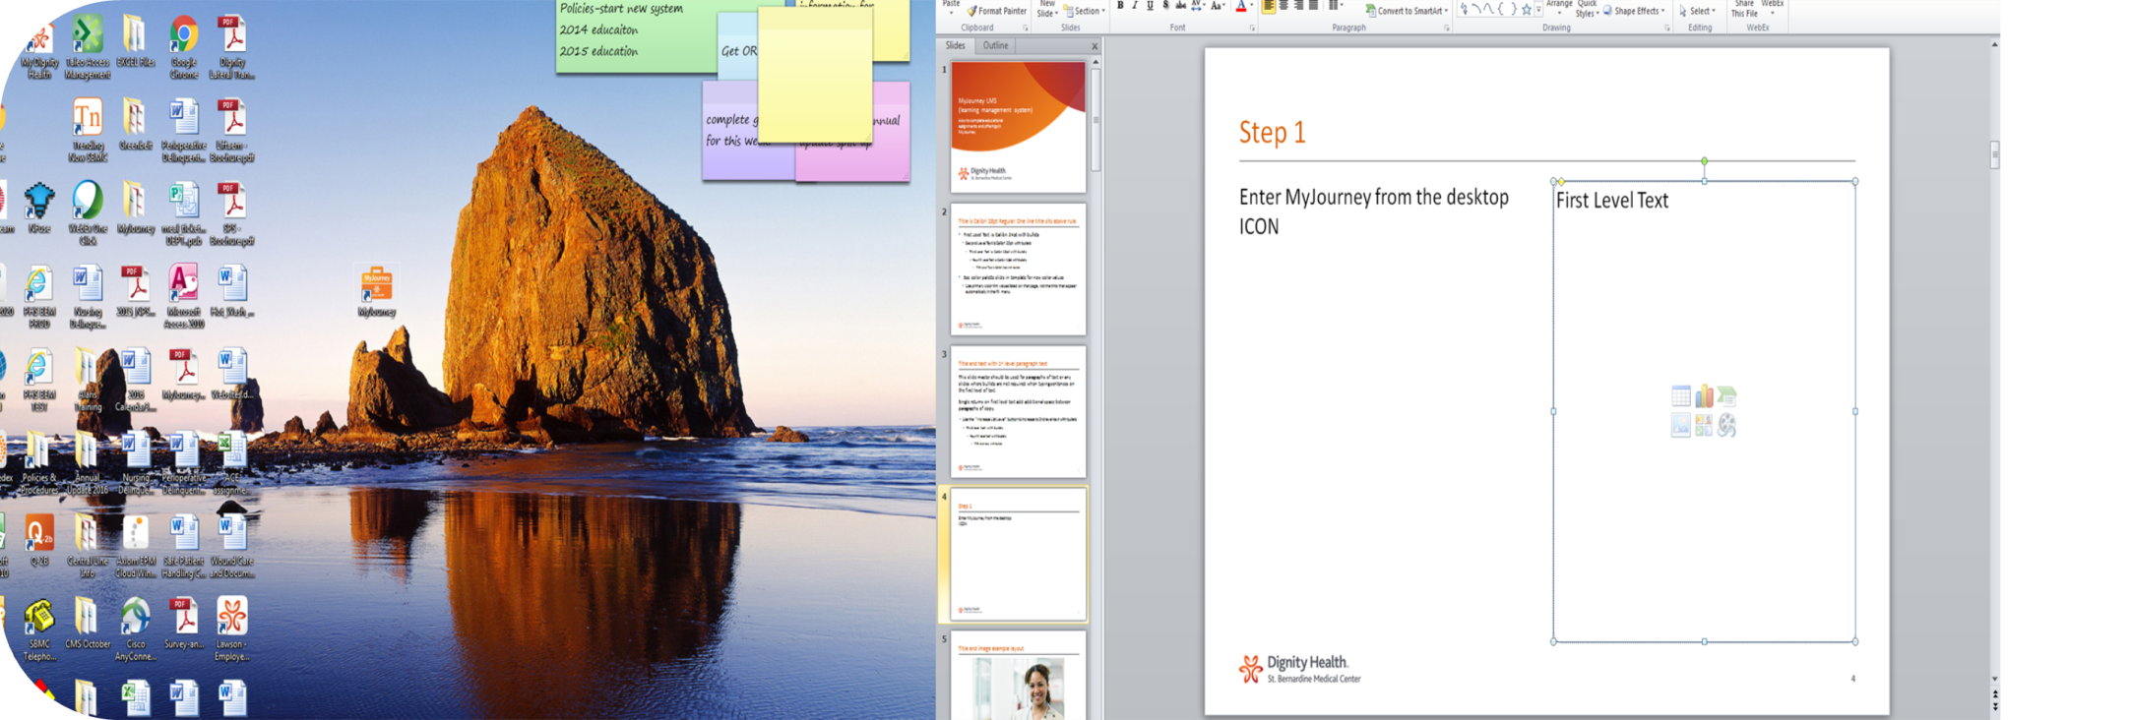
Using MyJourney Step 1
Enter MyJourney from the desktop ICON on the computer
The icon looks like a tiny orange suitcase.

Slide 5
The Home Page
Once you have signed on you will be in the home page. It should say Welcome, and your first name.
There are 4 gray circles and below those are your ACTION ITEMS
Action Items are things you have signed up for or are assignments given by education or your manager/director.
The due date shows if one is assigned.
You will find the course: MyJourney Learning Portal Overview Demo please watch this to acquaint yourself with the system.
The first assigned training will come shortly if not already in place.

Slide 6
First Assignments
Three assignments taking approximately 5 min each have been assigned to help you navigate the new system.
  MyJourney Learning Portal Overview Demo.
  MyJourney Learning-How to find and Sign up for training.
  MyJourney Learning-How to launch an Online Course.
Following these will be the first Mandatory Required Compliance Course required every year. (see next slide)

Slide 7
DH FY16 ACE Compliance Training
This will be the first educational assignment for 2016
The training is due by February 29th
Some educational offerings will still come on Tracker Trainer so don’t forget that website as well.
http://www.edutracker.com/trktrnr/TRK_login.aspx
We as an organization and an education department want to meet your needs for up to date knowledge to improve and maintain excellent practice in whatever position you are employed.

Slide 8
Thank You

